Slide 1
Project Name
Yukon Peng | Arwen Shackelford | Bobby Taylor | Sophie Tsai

Slide 2
Motivation
How is crime spread over Austin?
Is the a correlation between business reviews and crime per zip code?
What do the demographics in these Austin areas look like?
Notes:
What kind of data was needed to answer these questions? Where did we find it?

Slide 3
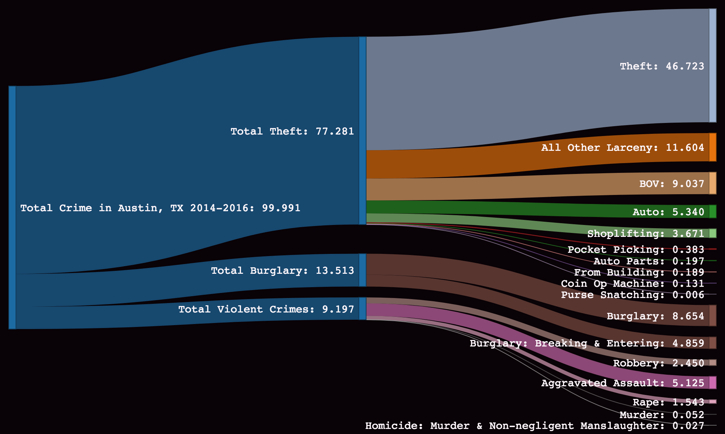
Crime Distribution in Austin, Texas in percentages
Notes:
What is the crime distribution across travis county?

Slide 4
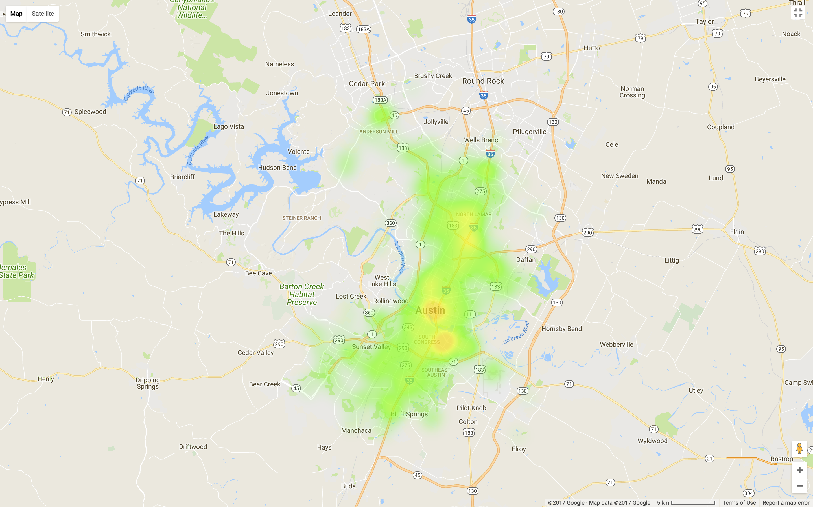
Total reported crime distribution in Austin, Texas, from 2014-2015

Slide 5
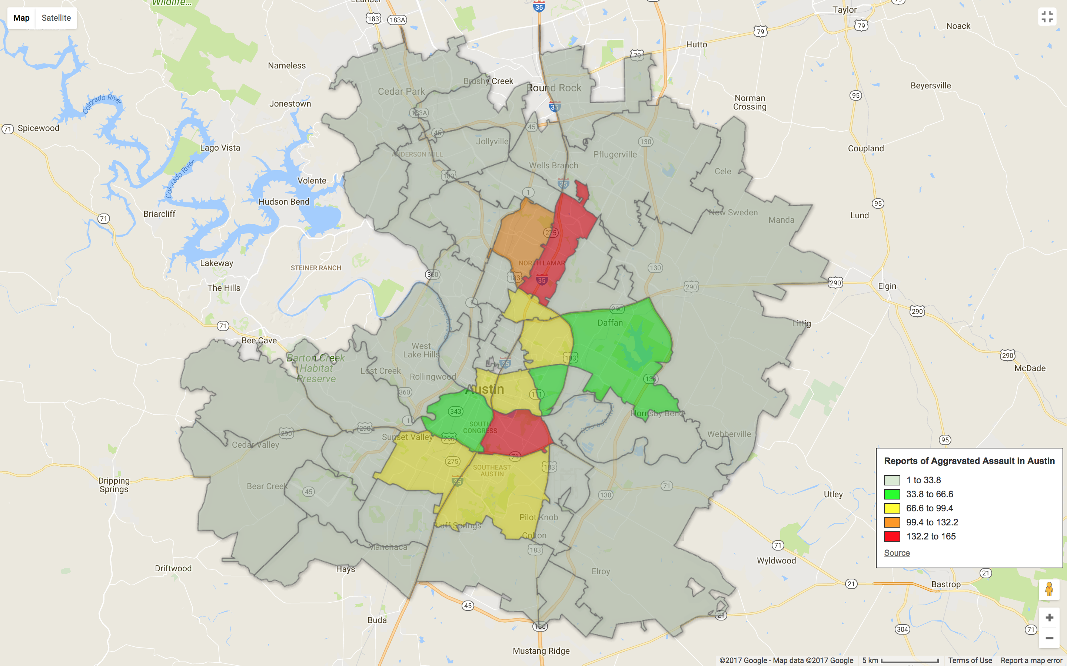
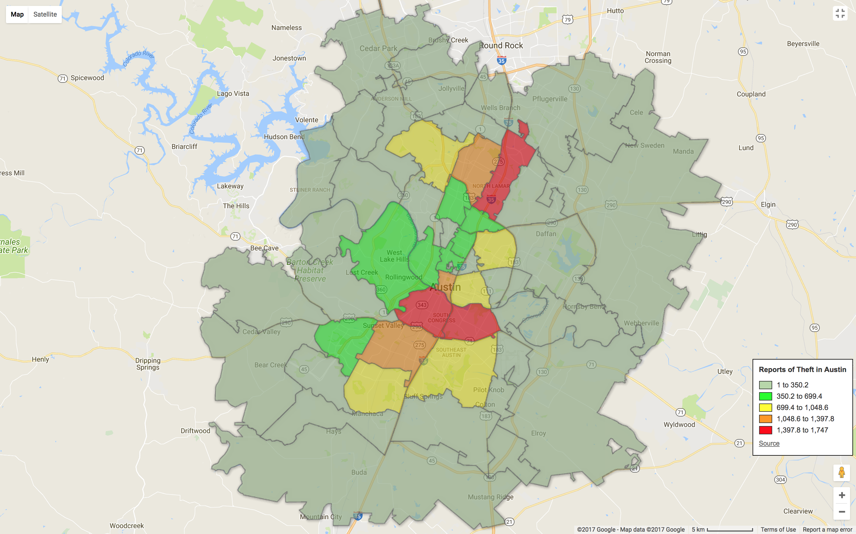
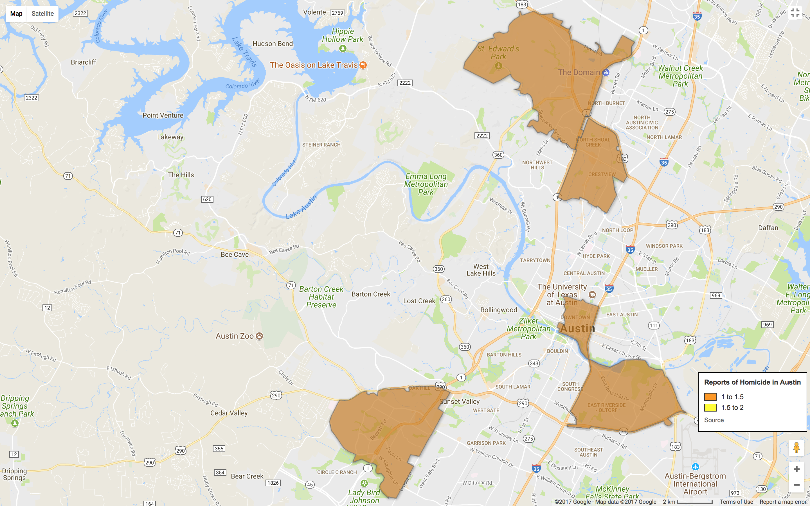
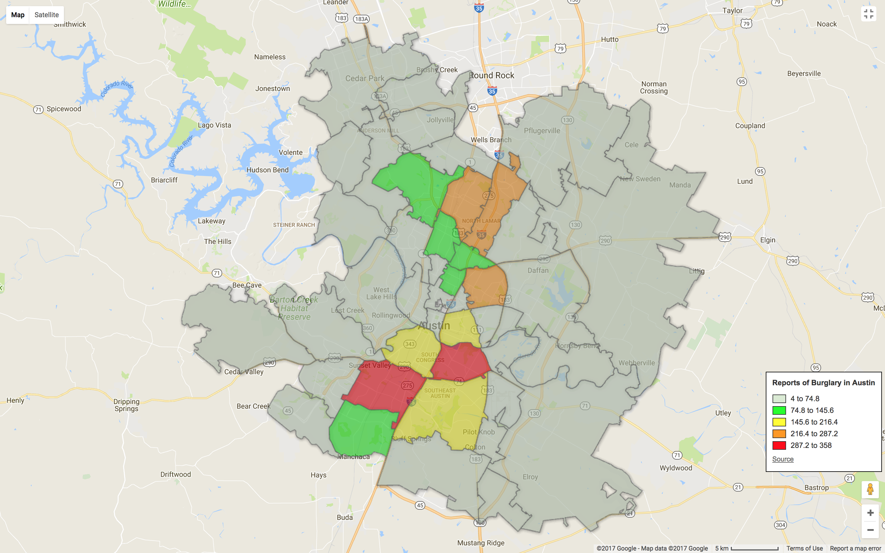
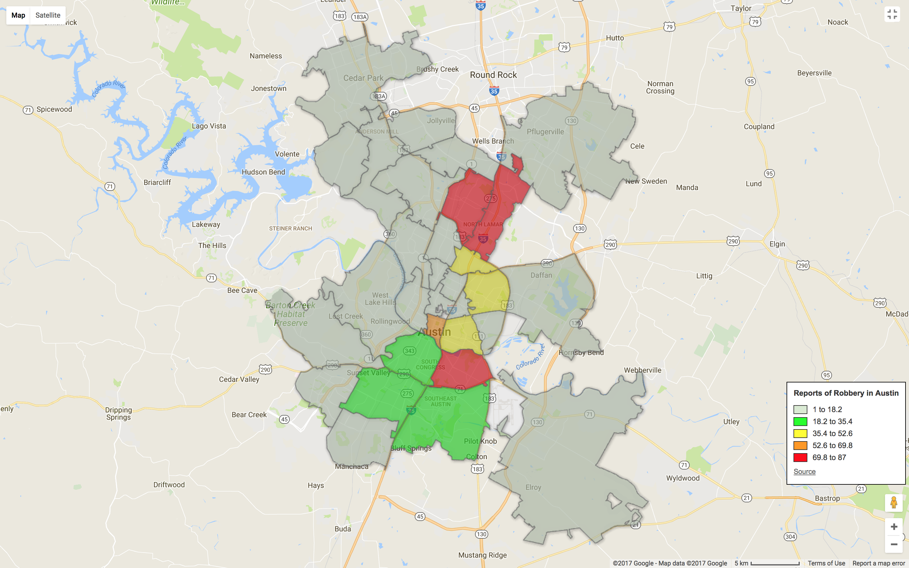
Crime Distribution by Type

Slide 10
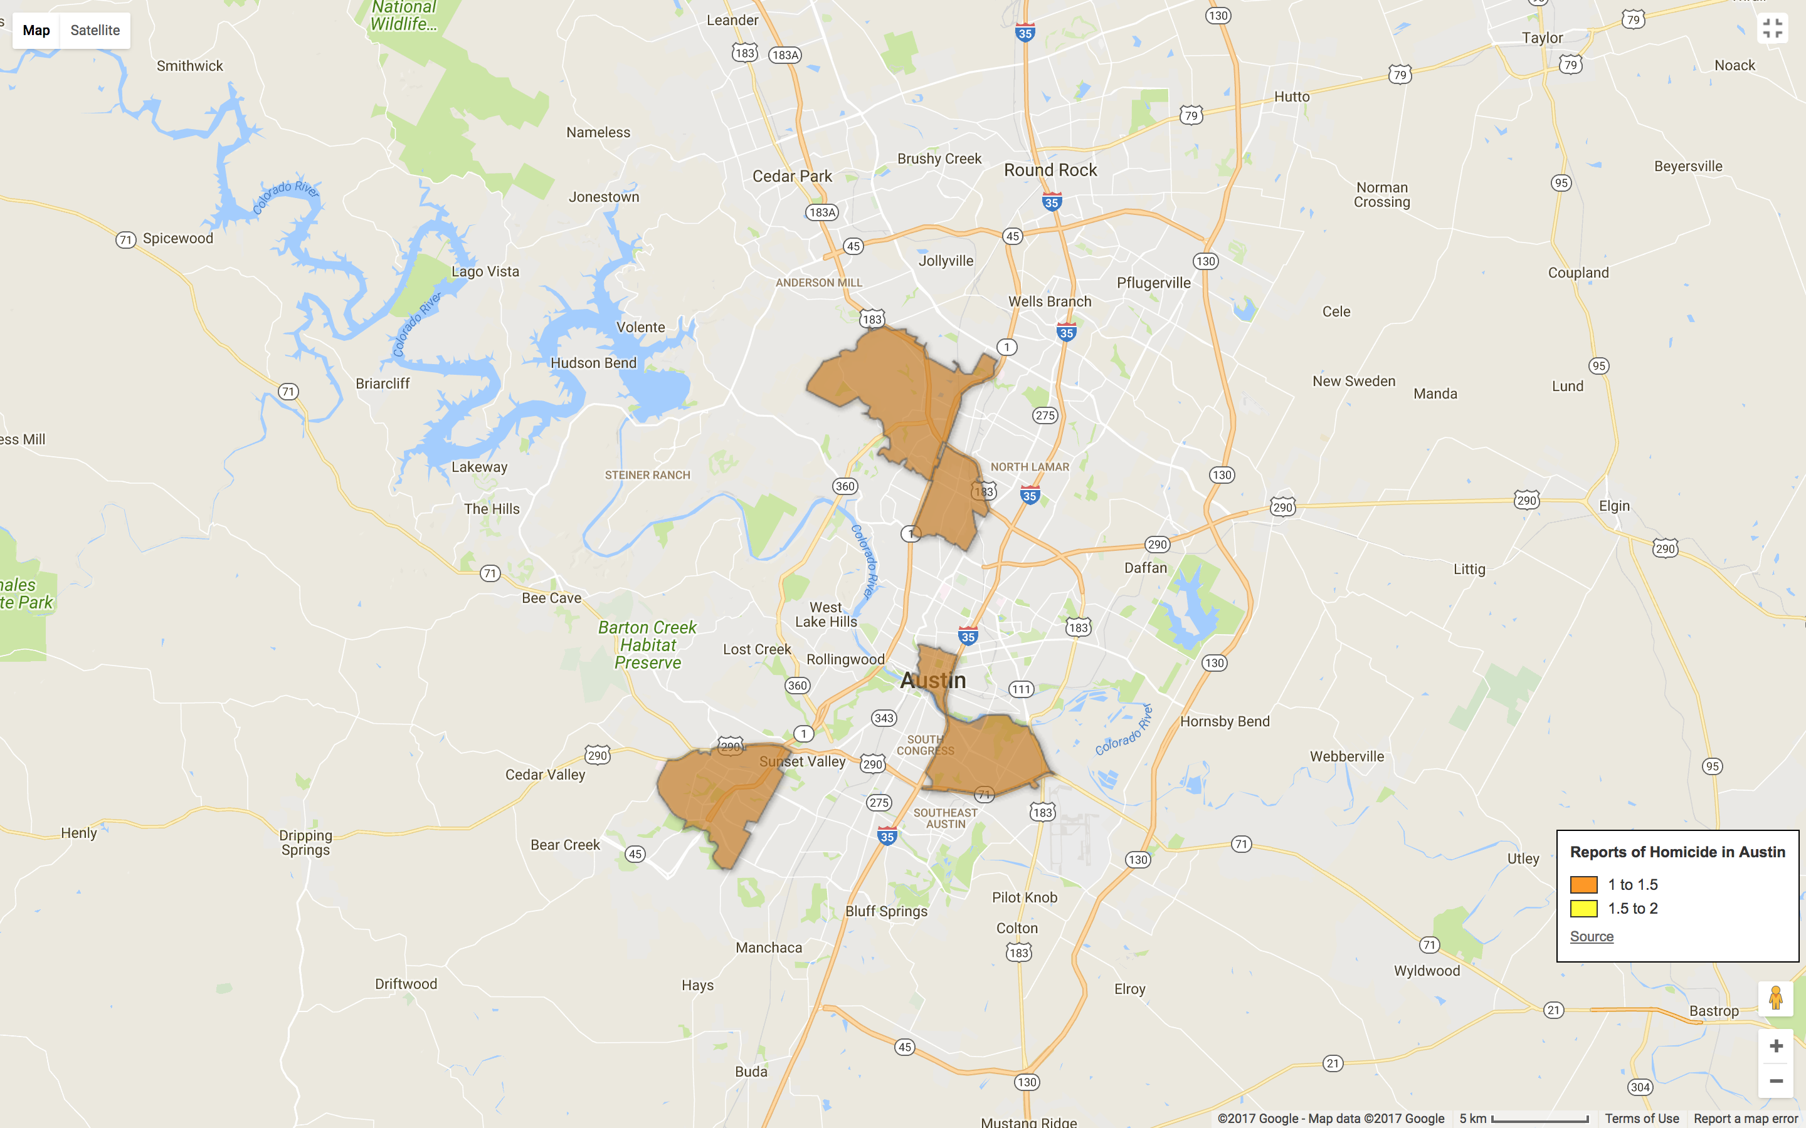

Slide 11
Business Reviews/Sentiment Analysis Info

Slide 12
Demographics Info

Slide 13
Data Cleanup and Exploration
Notes:
* Data Cleanup &amp; Exploration
* Describe the exploration and cleanup process
* Discuss insights you had while exploring the data that you didn't anticipate
* Discuss any problems that arose after exploring the data, and how you resolved them
* Present and discuss interesting figures developed during exploration, ideally with the help of Jupyter Notebook

Slide 14
Data Analysis
Notes:
* Data Analysis
* Discuss the steps you took to analyze the data and answer each question you asked in your proposal
* Present and discuss interesting figures developed during analysis, ideally with the help of Jupyter Notebook

Slide 15
Results
Notes:
* Discussion
* Discuss your findings. Did you find what you expected to find? If not, why not? What inferences or general conclusions can you draw from your analysis?

Slide 16
Difficulties and Additional Questions
Notes:
* Post Mortem
* Discuss any difficulties that arose, and how you dealt with them
* Discuss any additional questions that came up, but which you didn't have time to answer: What would you research next, if you had two more weeks?

Slide 17
Q&A

